Slide 1
Simplified Shopping System
SE 540 Final Project
Chandu Iraganaboina
ID: 2079688

Slide 2
Project Goal
Building a robust, maintainable shopping system by applying SOLID principles and design patterns. which involves creating a system that is easy to understand, extend, and maintain, ensuring that each component has a clear responsibility and can be easily modified or replaced without affecting other parts of the system.

Slide 3
Design Principles
Single Responsibility Principle (SRP):Each class has a single responsibility.
Open/Closed Principle (OCP):Classes are open for extension but closed for modification.
Liskov Substitution Principle (LSP):Subclasses can be used interchangeably with their base classes.

Slide 4
Design Principles
Interface Segregation Principle (ISP):Interfaces are specific to the needs of the client.
Dependency Inversion Principle (DIP):High-level modules are not dependent on low-level modules; dependencies are injected.

Slide 5
Design Patterns Implemented
Factory Pattern: Encapsulates the creation of product instances.
Builder Pattern: Constructs shopping carts with a fluent interface for adding/removing items and finalizing orders.

Slide 6
Technology Used
I have used Django a python framework , SQLite ,HTML Bootstrap and CSS to build the system, leveraging its powerful features to implement a clean and efficient architecture.

Slide 7
Key Features
User Authentication: Secure login system to associate users with their shopping carts.
Product Catalog: Manage and display products with essential information.
Order Processing: Efficient order placement and management.
Payment Processing: Simulated payment transactions using a mock payment gateway.
Logging: Record important events and transactions for monitoring and debugging.

Slide 8
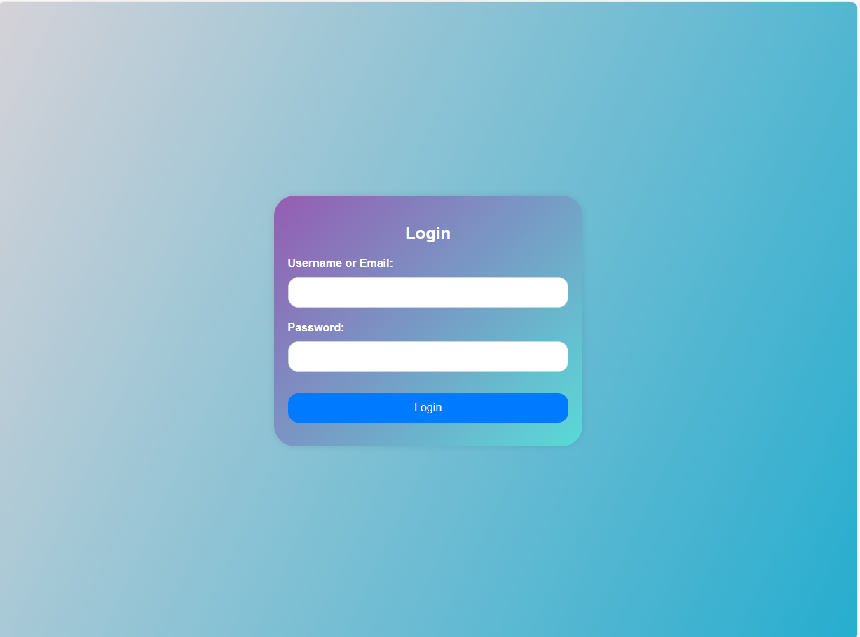
User Authentication
I have implemented a secure login system to associate users with their shopping carts.

Slide 9
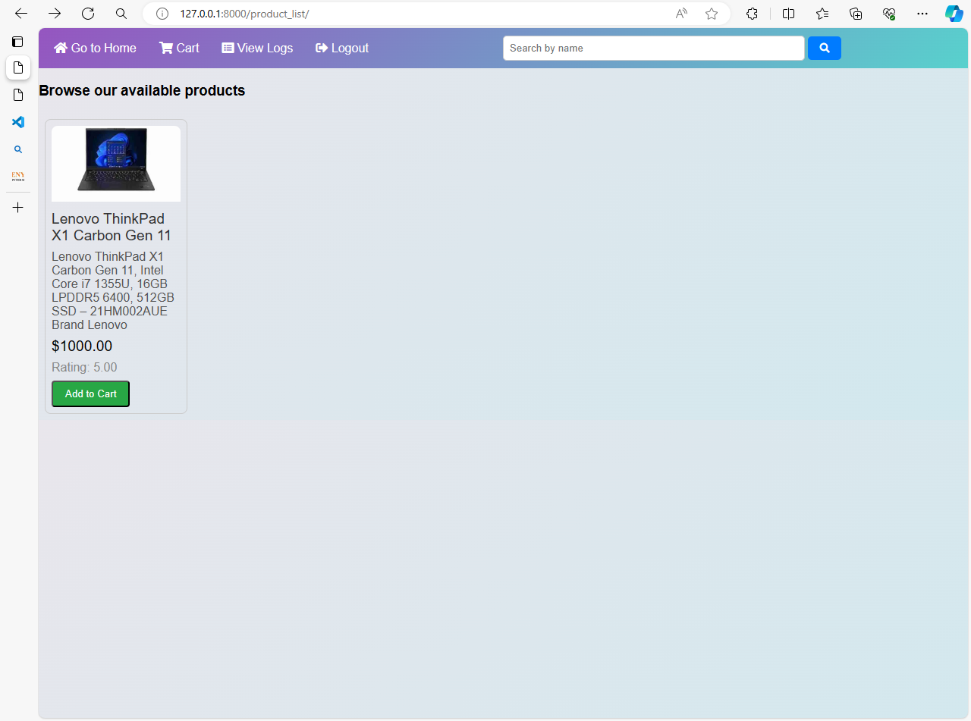
Product Catalog
The system is able to manage and display products with essential information.

Slide 10
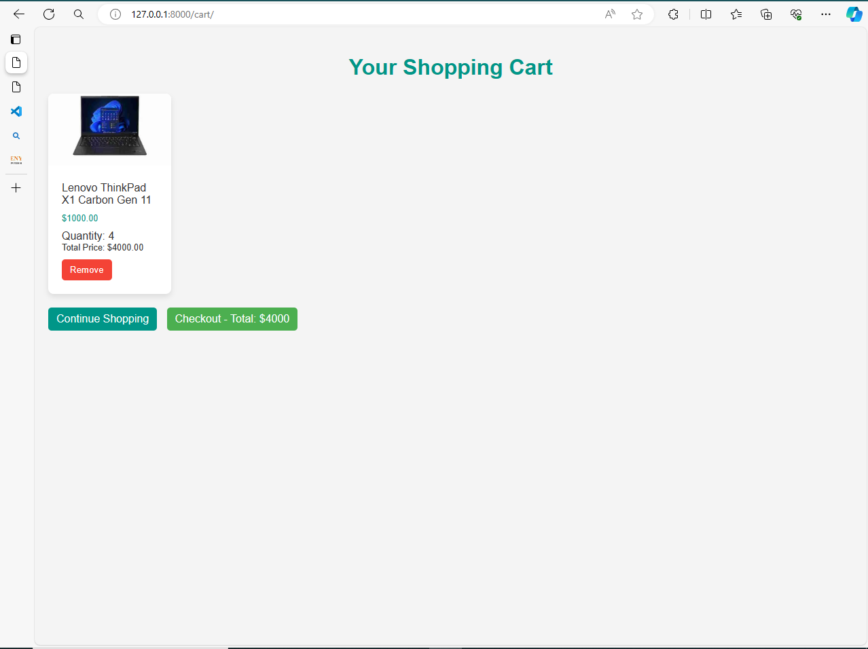
Order Processing
The system enables efficient order placement and management.

Slide 11
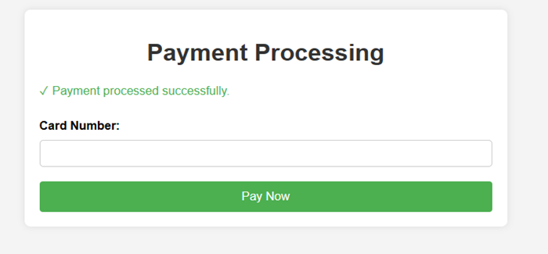
Payment Processing
We are able to Simulate payment transactions in the system using a mock payment
gateway.

Slide 12
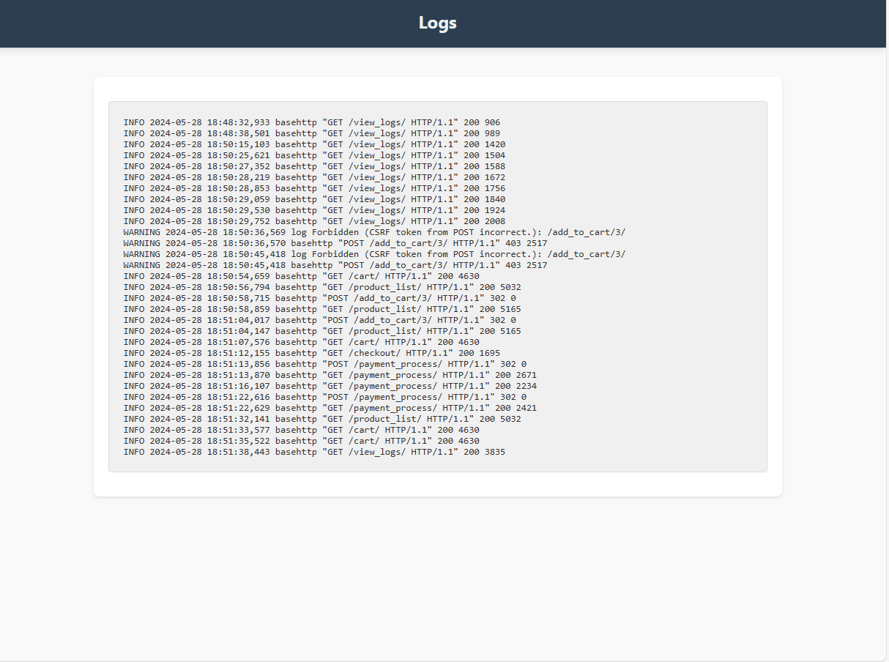
Logging
The system is able to record important events and transactions that occur in the system:

Slide 13
The End

